Slide 1
Templates
Unit-5

Slide 2
Content
Need of template
Types of templates
Class template,
Function template,
overloading of function template
recursion with template function
class template and inheritance
difference between templates and macro

Slide 3
Templates
A template is a blueprint or formula for creating a generic class or a function.
Templates are the foundation of generic programming, which involves writing code in a way that is independent of any particular type.

Slide 4
Generic Programming
Generic programming is a technique where generic types are used as parameters in algorithms so that they can work for a variety of data types.

Slide 5
Need for templates
A template allows us to create a family of classes or family of functions to handle different data types.
Template classes and functions eliminate the code duplication of different data types and thus makes the development easier and faster.
Multiple parameters can be used in both class and function template.
Template functions can also be overloaded.
We can also use non-type arguments such as built-in or derived data types as template arguments.

Slide 6
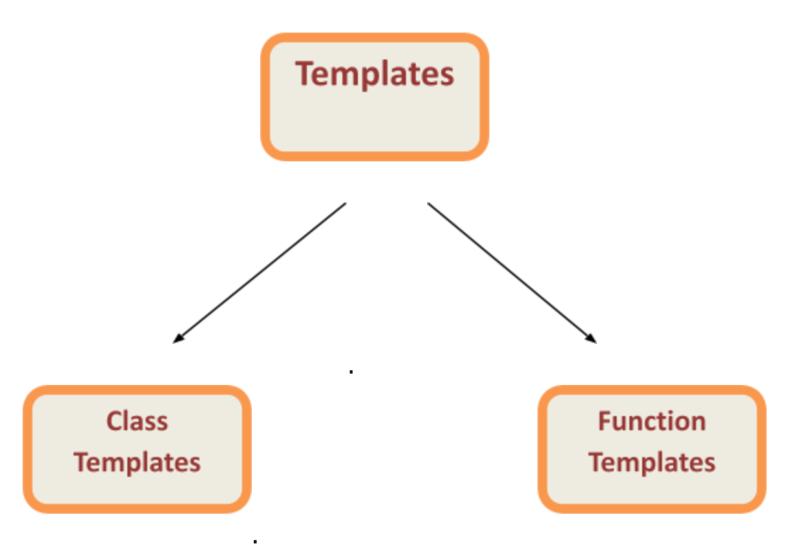
Types of templates

Slide 7
Function template
We can define a template for a function.
Generic functions use the concept of template.
a function
The type of the data that the function will define it depends up on the type of the data passed as a parameter.
It is created by using the keyword template
class or typename
Syntax:
template <class Ttype>
returnType functionName(parameterList)
{
// body of function.
}

Slide 8
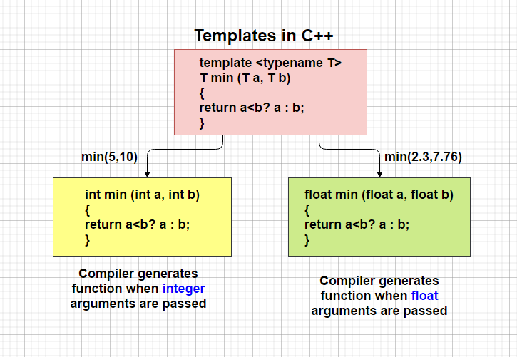
Function template
We can define a template for a function. For example, if we have an min() function, we can create versions of the min function for finding the minimum value from the int, float or double type values.

Slide 9
Example on function template
#include <iostream>
using namespace std;
template<typename T>
T mul(T a, T b)
{
return a * b;
}
int main()
{
cout<<mul(5.2,6.5);
return 0;
}

Slide 10
Which keyword can be used in template?
class
typename
both class & typename
function

Slide 11
Restrictions of Generic Functions
Generic functions perform the same operation for all the different data type.
For example If function is performing addition then it will perform addition only it will not perform subtraction, multiplication etc.…
There is the difference between function overloading and function template.

Slide 12
Class Template
A class template starts with the keyword template followed by template parameter(s) inside <> which is followed by the class declaration.
Once we've declared and defined a class template, we can create its objects in other classes or functions (such as the main() function) with the following syntax
ClassName<dataType> classObject;

Slide 13
Class template
Class template :
To create class in generic form.
Syntax
template <class type> class className
{
}

Slide 14
Example on class template
#include <iostream>
using namespace std;
template <class T>
class MCA{
public:T a,b;
T add(T x,T y)
{a=x;b=y;
return(a+b);}
};
int main(){
MCA<int>ob; cout<<ob.add(5,10)<<endl;
MCA<double>ob1;cout<<ob1.add(2.3,7.6);
}

Slide 15
What is the output of this program?
#include < iostream > #include < string > using namespace std;
template < typename T > void print_mydata(T output)
{
cout << output << endl;
}
int main()
{
double d = 5.5;
string s("Hello World"); print_mydata( d ); print_mydata( s ); return 0;
}
A. 5.5 Hello World
B. 5.5
C. Hello World
D. Error

Slide 16
Which is used to describe the function using placeholder types?
template parameters
template type parameters
template type
none of the mentioned

Slide 17
overloading of function template
Function template also can be overload
Same function name with different signature
is called function overloading and same thing we can apply for template also.
For example there is a template function for insert which take one parameter and with the same name insert we can create one more template with two parameters.

Slide 18
recursion with template function
The process in which a function call by itself is called recursion and the corresponding function is called as recursive function.
We can create recursive template function

Slide 19
How the template class is different from the normal class?
Template class generate objects of classes based on the template type
Template class saves system memory
Template class helps in making genetic classes
All of the mentioned

